Slide 1
Novel View Synthesis
Ruofeng Yang

Slide 2
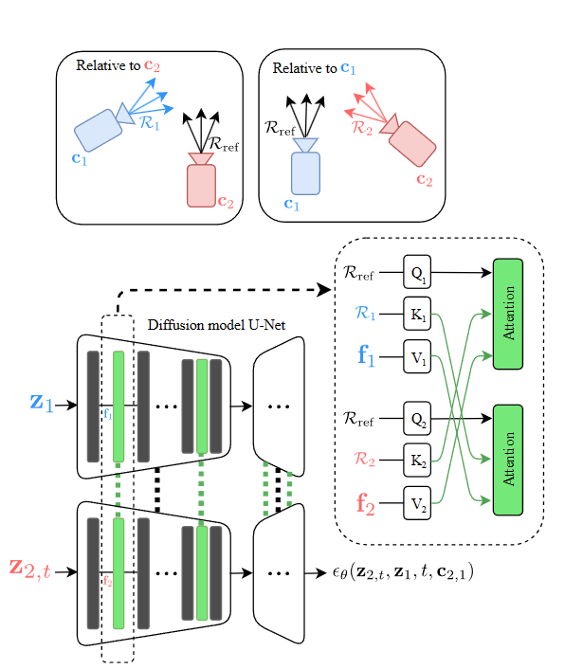
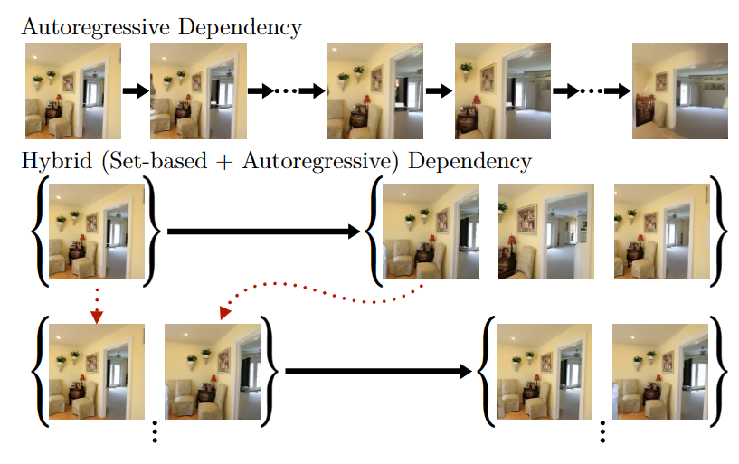
The paradigm of NVS
(A)
Latent Diffusion to obtain the latent feature
Share feature layer (Reference and target image) and add (relative) camera pose of reference images by using cross-attention layer. [1]
(B) Set to Set (Different frames) [2]
[1] Long-Term Photometric Consistent Novel View Synthesis with Diffusion Models. ICCV 2023.
[2] PolyOculus: Simultaneous Multi-view Image-based Novel View Synthesis. Arxiv 20240228.
1

Slide 3
The thoughts of NVS
Understanding of context information: diffusion transformer
Geometric Consistency from different angles:
(a) Using some consistency metric such as Thresholded Symmetric Epipolar Distance (TSED) [1] as reward and using RL method such as PPO to fine tuning the pretrained diffusion models [3][4].
(b) With some theoretical insight (Diffusion perspective [5][6]; RL perspective [7].
The choice of forward process:
The variance exploding forward process (VESDE) focus on the Negative Log-Likelihood (NLL) metric and some NVS works used VESDE [1][8]
[3] Training Diffusion Models with Reinforcement Learning. ICML 2023 workshop. 20230522
[4] Feedback Efficient Online Fine-Tuning of Diffusion Models. ICML 2023 workshop. 20230522
[5] Theoretical Insights for Diffusion Guidance: A Case Study for Gaussian Mixture Models. 20240304
[6] Reward-directed conditional diffusion: Provable distribution estimation and reward improvement. Neurips 2024
[7] Optimistic policy optimization with bandit feedback. ICML 2020
[8] Generative Novel View Synthesis with 3D-Aware Diffusion Models. ICCV 2023
2

Slide 4
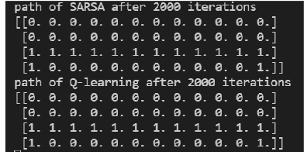
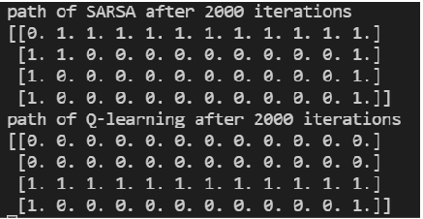
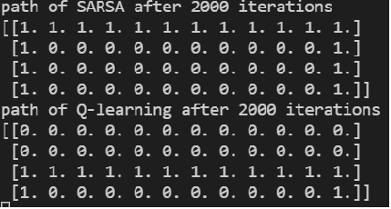



$$ε=0$$
$$ε=0.01$$
$$ε=0.1$$
1

